Slide 1
AI tools and Applications
Course Instructor : Sai Gupta
Department of Computer Science & Engineering

Slide 2
AI tools and Applications
AI tools and Applications: L (03)+T (01) ------ 2.5 Credits
Sem: I (CSE)
Course Code: V26AIL01
Total Modules : 05
Course Outcomes:
CO | Course Outcome | Knowledge Level
CO1 | Explain AI concepts and identify suitable AI tools for different tasks. | K2
CO2 | Apply prompting techniques to obtain useful and accurate AI-generated responses. | K3
CO3 | Experiment with AI tools for data analysis, visualization, and interpretation. | K3
CO4 | Apply AI tools to coding, writing, presentations, and productivity tasks. | K3
CO5 | Illustrate ethical, privacy, reliability, and security issues in using AI tools. | K2

Slide 3
Modules
Unit I: Introduction to AI and the AI Tools Landscape (3)
Unit II: Prompt Engineering and Generative AI Tools (3)
Unit 3: AI Tools for Data Analysis and Visualization (5)
Unit 4: AI Tools for Coding, Writing, and Productivity (3)
Unit 5: Ethics, Reliability, and Emerging Trends (3)

Slide 4
Text Books:
Generative AI in practice: 100+ amazing ways generative artificial intelligence is changing business and society, Marr, B. (2024), Wiley.
Co-intelligence: Living and working with AI, Mollick, E. (2024), Portfolio/Penguin.
References:
Prompt engineering for generative AI: Future-proof inputs for reliable AI outputs. Phoenix, J., & Taylor, M. (2024), O'Reilly Media.
Introduction to generative AI: A practical guide to generative AI, large language models, and more, Dhamani, N., & Engler, M. (2024), Manning Publications.
Education and technology: Key issues and debates, Selwyn, N. (2022), 3rd ed. Bloomsbury Academic.

Slide 5
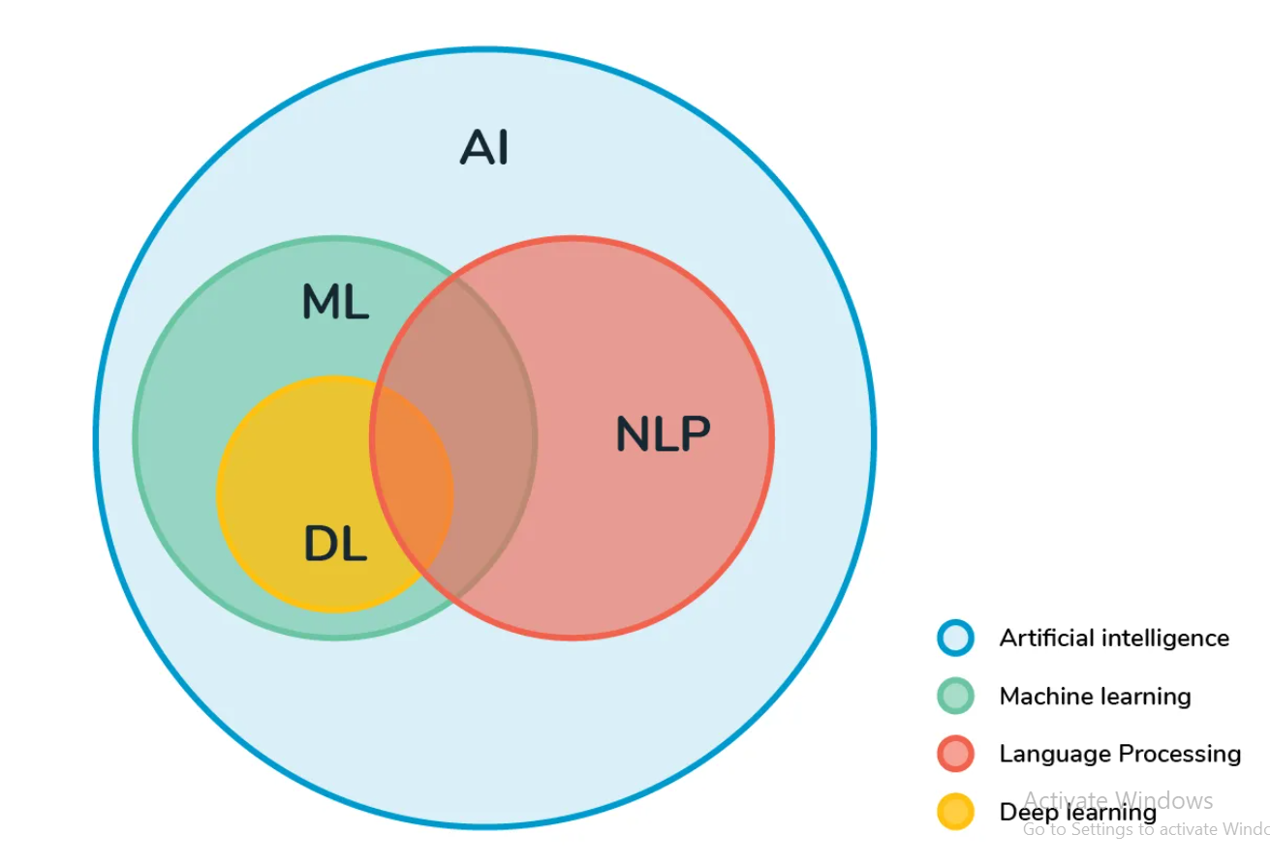

Slide 6
AI: the broad idea that machines can intelligently execute tasks by mimicking human behavior
ML: Subset of AI, revolves around the idea that machines can learn & adapt through experience & data to complete specific tasks.
DL: It attempts to mimic the human brain through NNs.

Slide 7
Laptop Specifications
Target:
Processor : i5 / i7
RAM : 16 GB RAM
Memory : 512 GB NVMe SSD
Integrated graphics
14–15.6" FHD/1200p display
Perfect for:
C/C++ + Java + Python + Web Development + DBMS + DSA + college projects
₹50,000–₹65,000

